Slide 1


Introduction to Circuits Analysis
by Andrew G. Bell
abell118@ivytech.edu
(260) 481-2288
Lecture 3

Slide 2
PART II
Basic Circuit Analysis

Slide 3
CHAPTER 3
Ohm’s Law

Slide 4
Relationship of Current to Voltage*
A Direct Relationship
An increase in voltage will result in an increase in current.
A decrease in voltage will result in a decrease in current.
*Resistance held constant

Slide 5
Relationship of Current to Resistance*
Indirect Relationship
An increase in resistance will result in a decrease in current.
A decrease in resistance will result in an increase in current.
* Voltage held constant

Slide 6
Mathematical Relationship of V, I, and R
Formulated with three variables:
V, I, and R
Relationship called Ohm’s law
Three forms exist:

Slide 7
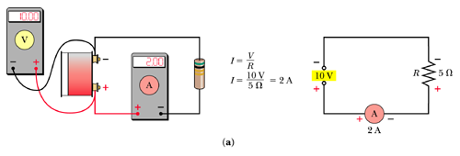
The Circuit

Slide 8
Ohm’s Law Examples
Voltage = 25 V
Resistance = 25 Ω
I = _____

Slide 9
Ohm’s Law Examples (cont.)
Voltage = 15 V
Resistance = 1 kΩ
I = _______

Slide 10
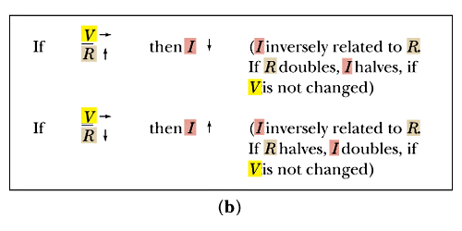
Direct and Inverse Relationships
Inverse relationship

Slide 11
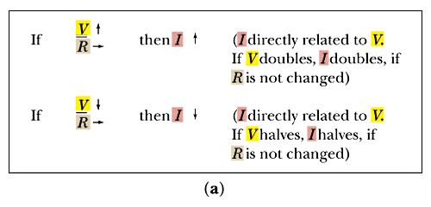
Direct and Inverse Relationships (cont.)
Direct relationship

Slide 12
Ohm’s Law Examples
Resistance = 50 Ω
Current = 2.5 A
Voltage = _______

Slide 13
Ohm’s Law Examples (cont.)
Resistance = 10 kΩ
Current = 4 mA
Voltage = ______

Slide 14
Ohm’s Law Examples (cont.)
Current = 15 mA
Voltage = 15 V
Resistance = _______

Slide 15
Ohm’s Law Examples (cont.)
Current = 4 mA
Voltage = 60 V
Resistance = _______

Slide 16
Current Flow Notations
Electron Flow: Flow is from (–) to (+)
Conventional Flow*: Flow is from (+) to (–)
Polarity: One point in a component or circuit being considered more negative or positive than another
*Older notation

Slide 17
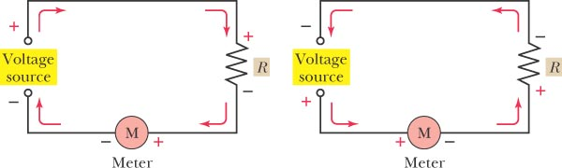
Circuit Representation of Current Flow

Slide 18
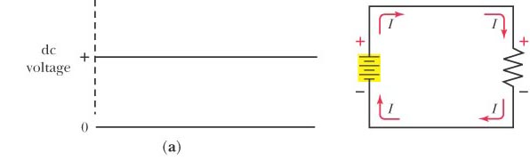
DC Characteristics

Slide 19
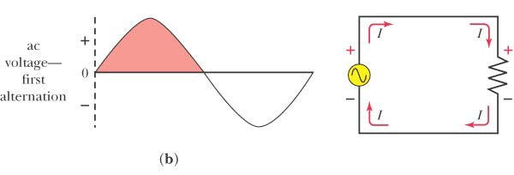
AC Characteristics

Slide 20
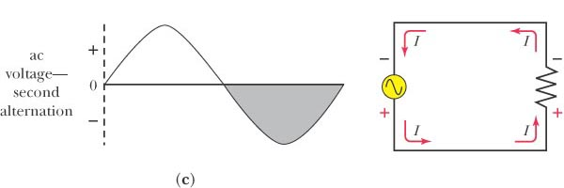
AC Characteristics (cont.)

Slide 21
Work, Energy and Power
Work: Expenditure of energy
Mechanical Work = Force × Distance
Electrical Work = Charge × Voltage
Energy: Ability to do work
Energy = Power × Time
Power: Rate of energy usage
Power = Energy/Time

Slide 22
Power and Ohm’s Law
Power = Current x Voltage
P (watts) = I (amps) x V (voltage)
If I = 25 mA and V = 10 V:
P = (25 mA) x (10 V) = 250 mW

Slide 23
Relationships
Note that if the current in the last slide doubles, the power will also double.
P = IV = (50 mA)(10 V) = 500 mW

Slide 24
Power vs. Resistance

Slide 25
Relationships Between Power and Resistance
For a constant resistance:
Doubling the current or voltage will result in a quadrupling of power.
Halving the current or voltage will result in a reduction in power by one-fourth.

Slide 26
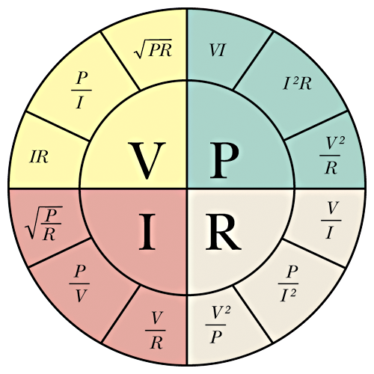
Equation Summary

Slide 27
Basic Circuit Examples
R = 10 kΩ, I = 10 mA, V = _____
V = 100 V
V = 50 V, I = 2 mA, R = ______
R = 25 kΩ
V = 75 V, R = 10 kΩ, I = ______
I = 7.5 mA

Slide 28
Power Calculations
V = 100 V, I = 2 mA, R = _____, P = _____
R = 50 kΩ, P = 200 mW
V = 250 V, R = 25 kΩ, I = _____, P = _____
I = 10 mA, P = 2.5 W

